Slide 1
Chapter 12
Marketing Channels: Delivering Customer Value

Slide 2
Supply Chains and the
Value Delivery Network
Supply Chain Partners
Upstream partners include raw material suppliers, components, parts, information, finances, and expertise to create a product or service
Downstream partners include the marketing channels or distribution channels that look toward the customer

Slide 3
Supply Chains and the
Value Delivery Network
Supply Chain Views
Supply chain “make and sell” view includes the firm’s raw materials, productive inputs, and factory capacity

Slide 4
Supply Chains and the
Value Delivery Network
Value Delivery Network
Value delivery network is the firm’s suppliers, distributors, and ultimately customers who partner with each other to improve the performance of the entire system

Slide 5
The Nature and Importance of Marketing Channels
How Channel Members Add Value
Intermediaries offer producers greater efficiency in making goods available to target markets. Through their contacts, experience, specialization, and scale of operations, intermediaries usually offer the firm more than it can achieve on its own.

Slide 6
The Nature and Importance of Marketing Channels
How Channel Members Add Value
From an economic view, intermediaries transform the assortment of products into assortments wanted by consumers
Channel members add value by bridging the major time, place, and possession gaps that separate goods and services from those who would use them

Slide 7
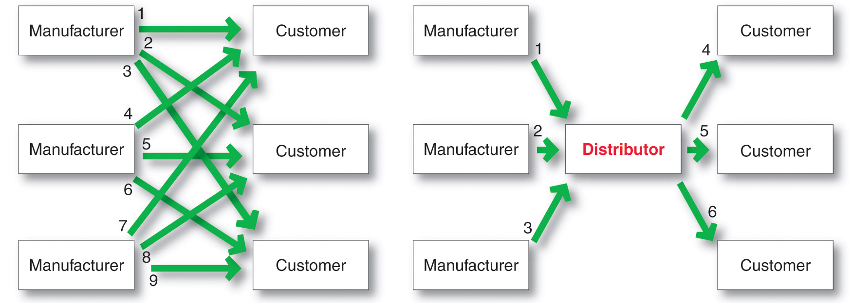
The Nature and Importance of Marketing Channels
How Channel Members Add Value

Slide 8
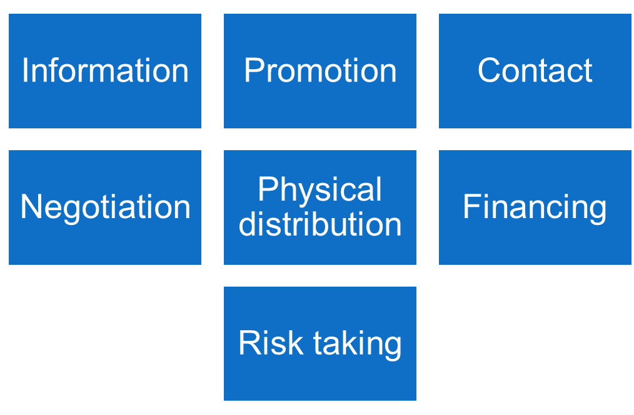
The Nature and Importance of Marketing Channels
How Channel Members Add Value

Slide 9

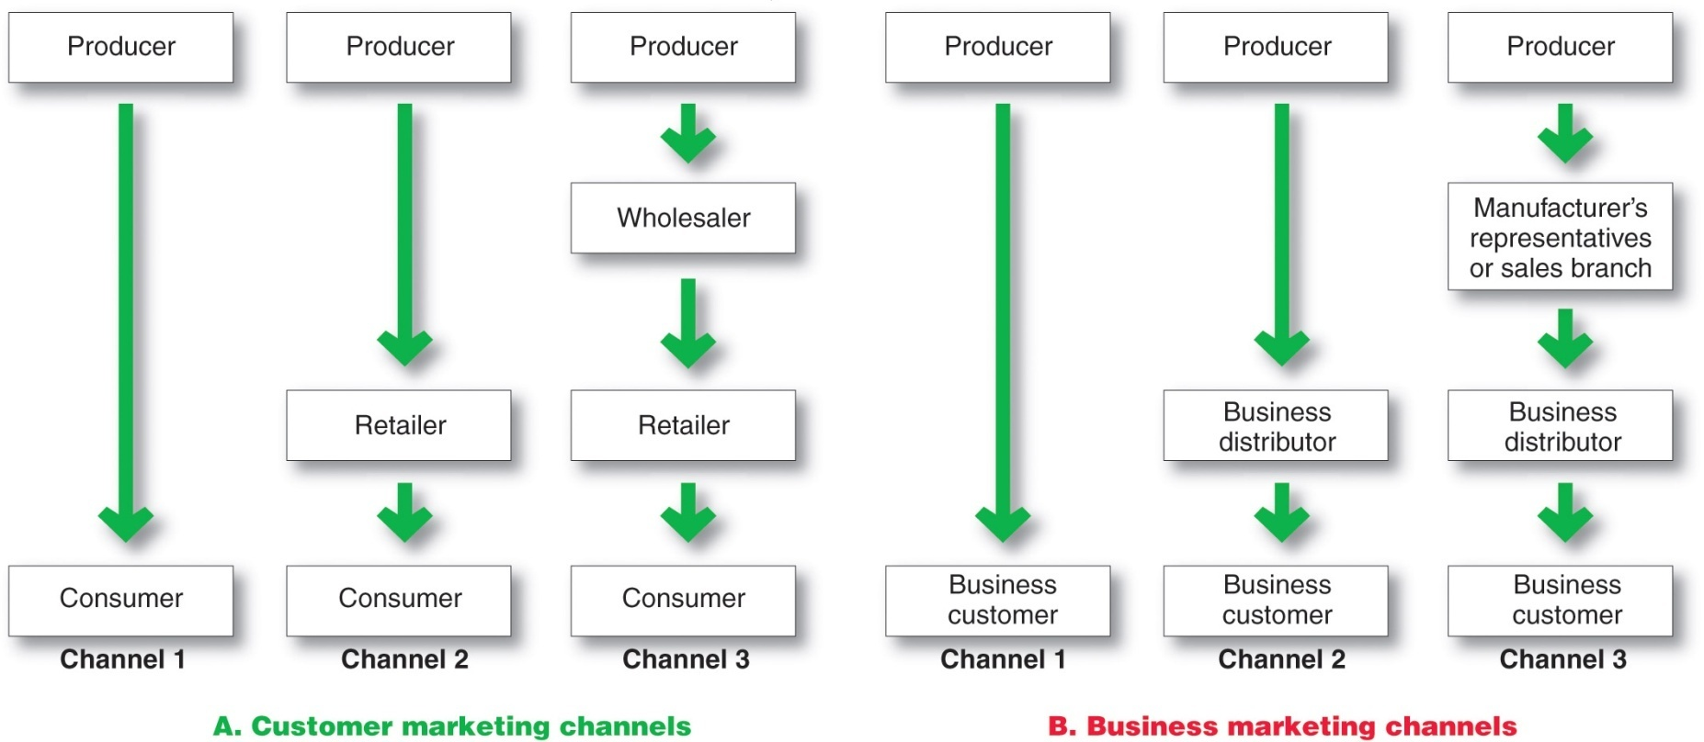
The Nature and Importance of Marketing Channels
Number of Channel Levels

Slide 10
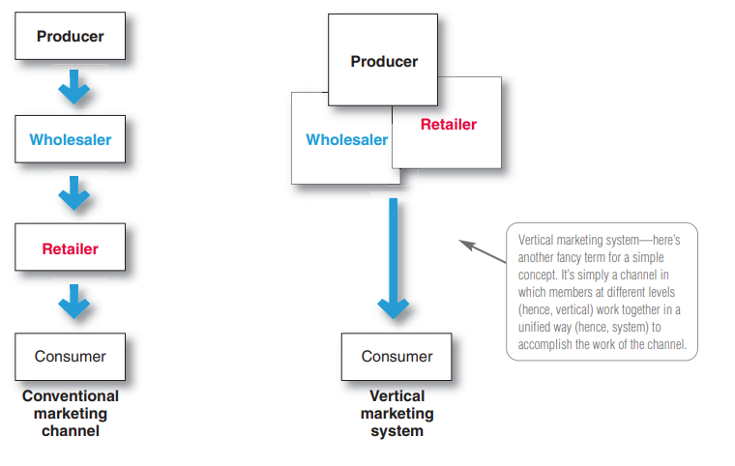
Conventional/Vertical Marketing Systems

Slide 11
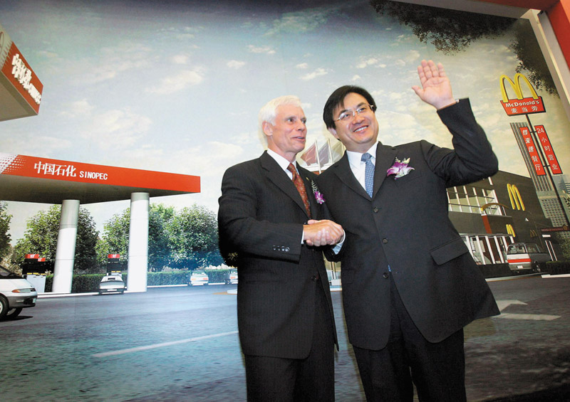
Channel Behavior and Organization
Horizontal Marketing System
  Horizontal marketing systems are when two or more companies at one level join together to follow a new marketing opportunity. Companies combine financial, production, or marketing resources to accomplish more than any one company could alone.

Slide 12

Channel Behavior and Organization
Multichannel Distribution Systems
Hybrid Marketing Channels
  Multichannel Distribution systems (Hybrid marketing channels) are when a single firm sets up two or more marketing channels to reach one or more customer segments

Slide 13
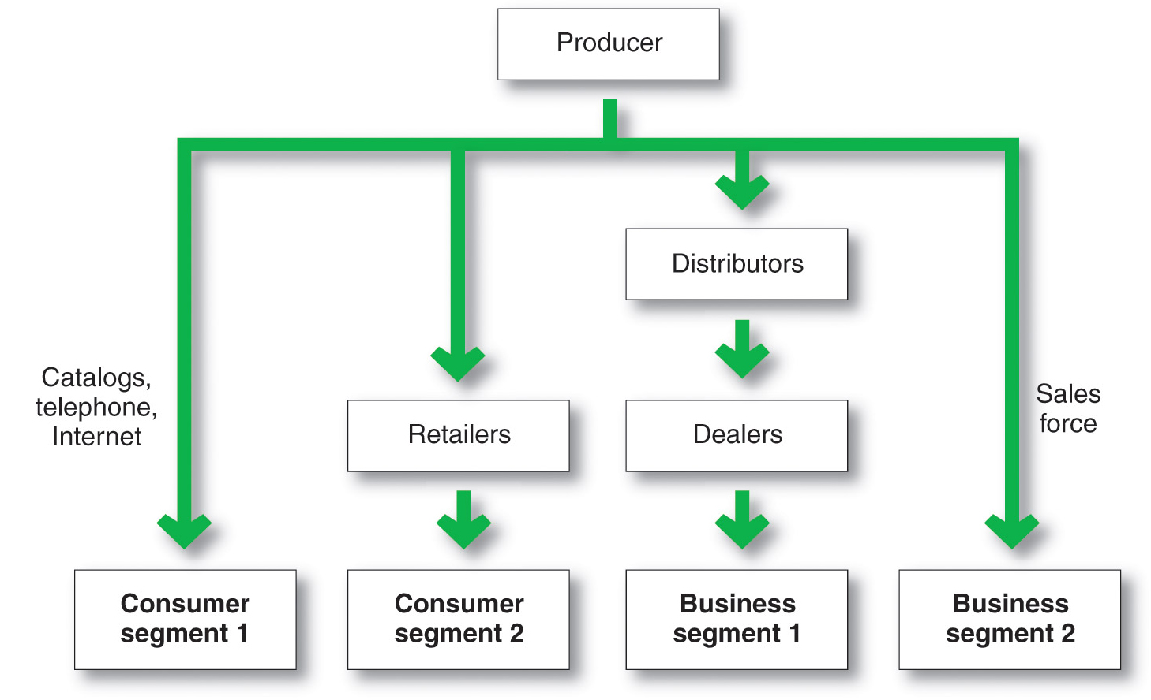
Multichannel Distribution System

Slide 14
Marketing Channel Design
Channel Design Decision
Analyzing Consumer Needs
Setting Channel Objectives
Identifying Major Alternatives
Evaluating the Major Alternatives
Designing International Distribution Channels

Slide 15
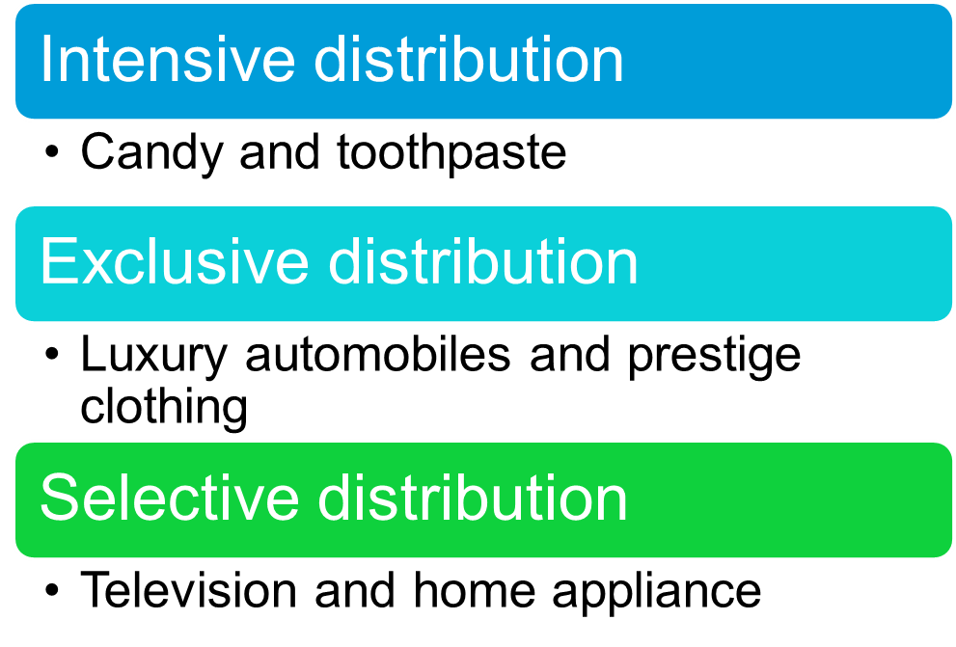
Channel Design Decisions
Identifying Major Alternatives

Slide 16

Channel Design Decisions
Designing International Distribution Channels
Channel systems can vary from country to country
Must be able to adapt channel strategies to the existing structures within each country

Slide 17
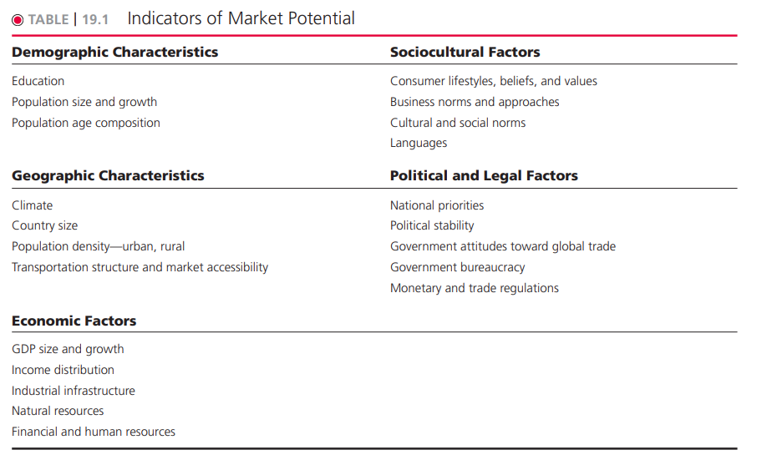
Expanding Globally
Indicators of Market Potential

Slide 18
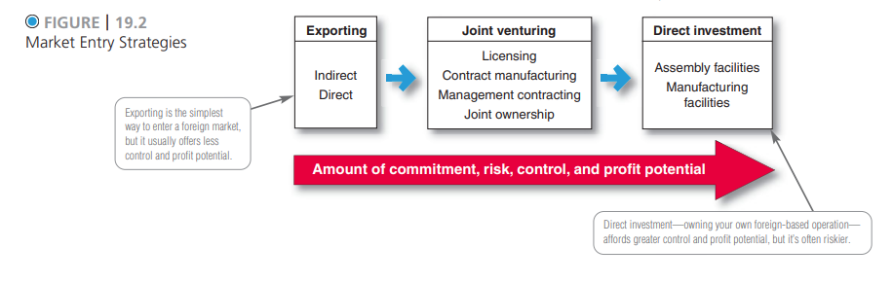
Expanding Globally
Deciding How to Enter the Market
Notes:
McDonald's & KFC Sultan Ali Lakhani, Lakson Group & Raza Pirbhai
CPEC as Joint venture Example in Pakistan.

